Slide 1

Software Engineering (CS3201) System Models
Avinash

Slide 2

System Modelling

Slide 3
Introduction
System Models are something that may be developed as part of Requirements Engineering (though they may also be used in other processes, especially in design phase)
System Models: Graphical models (diagrams), which can be used to represent Software systems
System Modelling Perspectives (how you want to view system):
Context
Interaction
Structure
Behavior
UML provides a set of diagrams that can be used to represent system models
Different people want to view a system (or anything) from different points of view. End user might be interested in how he/ she/ they interact with the system, an architect might be interested in class organization, a developer might be interested in behavior (message passing between classes).

Slide 4
Introduction
One more facet to System Modelling – Model driven engineering
Model driven engineering: Executable system is generated from structural and behavioral models
Example tools (to convert System Models into executable code, configuration files, etc.):
Eclipse Modelling Framework
Papyrus
IBM Rational Rhapsody

Slide 5
System Modelling
System modeling: Process of developing abstract models of a system
"abstract model": Simplified representation of the system, process (actions, activities) or data (data stored, processed, exchanged)
There are different kinds of abstract models, each differ in the kind of view or perspective it presents
System modelling, in common usage, means representing the system in graphical notation based on diagram types in the UML (however, there can be formal mathematical models as well – not covered at this point in the course)

Slide 6
Why (and where to) use models?
In Requirements Engineering: To help find/ understand detailed requirements for a system
In Design Process: Describe the system to engineers implementing the system
After Implementation: To document the system structure and operation

Slide 7
What do you usually model?
Existing Systems
Systems to be developed
Existing systems models:
Used in Requirements Engineering to clarify what existing system does
Focus stakeholder discussion on strengths and weaknesses
Models of systems to be developed:
Explain the proposed requirements to the stakeholders
Engineers use these models to discuss design and document for implementation
Model driven Engineering process: Generate complete or partial system from models
Notes:
We model existing systems to:
Make hidden processes visible
Resolve conflicting stakeholder views
Identify inefficiencies
Understand before improving
Document knowledge that exists only in people’s heads

Slide 8
What is / is NOT a system model
System Model is NOT a complete representation of the system
Purposely leaves out detail making it easier to understand
It is an abstraction of the system, rather than a representation of the system
An abstraction is a deliberate simplification of the system, picking up the most salient features
Sommerville: "Slides are an abstraction of the textbook. An English to Italian translation of the book is an alternate representation"

Slide 9
Models and Perspectives
You may make different models of the system to represent different perspectives:
External perspective: Models the context or environment of the system (eg: context diagram)
Interaction perspective: Models the interactions between a system and its environment, or between the components of system (eg: sequence diagram)
Structural perspective: Models the organization of a system or the structure of the data processed by the system (eg: class diagrams)
Behavioral perspective: Models the dynamic behavior of the system and how it responds to events (eg: state diagrams)

Slide 10
Three common usages of graphical models
To stimulate and focus discussion about an existing or proposed system
As a way of documenting an existing system
In model-based engineering processes, as a detailed system description that can be used to generate a system implementation (here the models have to be complete)

Slide 11
Modelling and UML
UML has 13 different types of diagrams to support creation of different kinds of system models
Class diagrams: Shows the system structure (by showing the classes/ objects in the system and their association/ dependency)
Use case diagrams: Interaction between system and environment
Sequence diagrams: Interaction between actors and system and system components
Activity diagrams: Activities involved in a process or in data processing
State diagrams: System response to internal and external events

Slide 12
Various System Models – Context, Interaction, et al.

Slide 13
Context Models
At early stage of system specification, you need to decide on system boundaries
System boundaries? What is, and is not, part of the system
Involves working with stakeholders to decide what functionality should be included within a system, and what processing and operations should be carried out by the system's environment
This decision should be made early in the process to limit system cost and time needed to understand the system requirements and design

Slide 14
System Boundary?!
In simple terms, A system boundary in a context model defines what is inside and outside the system you are designing. It separates the system from external elements (environment) like users, other systems, and hardware that interact with it
Basically, the system boundary helps clearly define what the system is responsible for and what it depends on from the outside
Example 1: Food delivery app
System boundary includes:
The app itself (ordering, payments, tracking)
The database storing restaurant and user information (it is being developed/ controlled by the system developers)
Outside system boundary:
External services like Google Maps (though the app may interact with it)
Delivery drivers (they are external users)

Slide 15
System Boundary (boundaries are important)
Example 2: Student portal
System boundary defines what is inside the portal (what the system controls) and what is outside (external systems it interacts with)
Inside boundary (what system controls)
Student login & authentication
Course registration & schedules
Viewing grades & transcripts
Fee payment system
Outside boundary (external to system / outside system responsibility)
Email system (separately managed – by Microsoft outlook)
External payment gateways (e.g., UPI, bank systems)
The system boundary helps define what the university portal is responsible for versus what it just connects with but doesn’t control

Slide 16
Context Models
In some cases, the boundaries between system and environment are clear
Sometimes, the system boundaries are not made explicit (and can be configured to have different boundaries for different users) **
Sometimes, system boundaries maybe defined by non-technical factors (social and organizational factors) ***
Context models normally show the system and the environment (which may contain other systems). However, they do not show the types of relationships between the systems in the environment and the system that is being specified
** - Refer slide 21
*** - Refer slide 21

Slide 17
Context Models
However, it might be important to know relationships between system and other systems in environment (external systems might produce or consume data for our system, direct or indirect network connections, etc.)
These relationships are important, and can be captured (indirectly) using business process models
UML activity diagrams may be used to show the business processes

Slide 18
Business Process Models
A Business Process Model (BPM) is a visual way of showing how a business process works step by step. It helps understand the flow of tasks, decisions, and interactions between people and systems
Generally represented by UML Activity diagram (you will see this in your next SE lab Assignment 6)

Slide 19
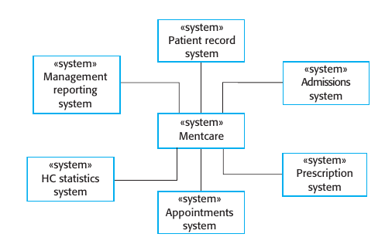
Context Model: Example (SOM., pg. 142)

Slide 20
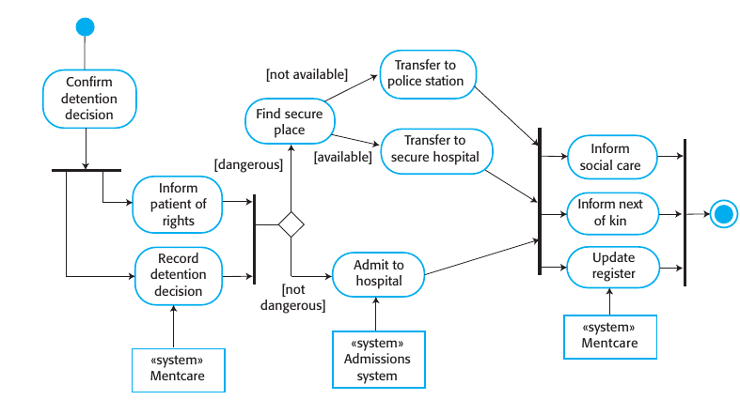
Business Process Model: Example (SOM., pg. 143)

Slide 21
Final thoughts – Context Models
** - System boundaries are not always rigid and are based on how users interact with the system. In a university portal (system), the system does not include <taxation> module for the student, whereas the professor has a <taxation> module within the system boundary
*** - Technology alone does not determine scope (boundary) of the system. Non-technical factors can play a role in defining boundary. The system does not just depend (and include) what it can do technically, but also covers non-technical areas. Example: Finance dept processes fees manually, but some might include it inside Juno to show that it is part of the overall system of Juno (which is responsible for all student matters)

Slide 22
Structural Models
"Structural models of software display the organization of a system in terms of the components that make up that system and their relationships" (SOM., pg. 149)
Structural models can be static OR dynamic
Static: Shows organization of system (its design, components that make it)
Dynamic: Organization of a system while executing (a snapshot)

Slide 23
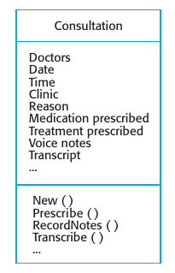
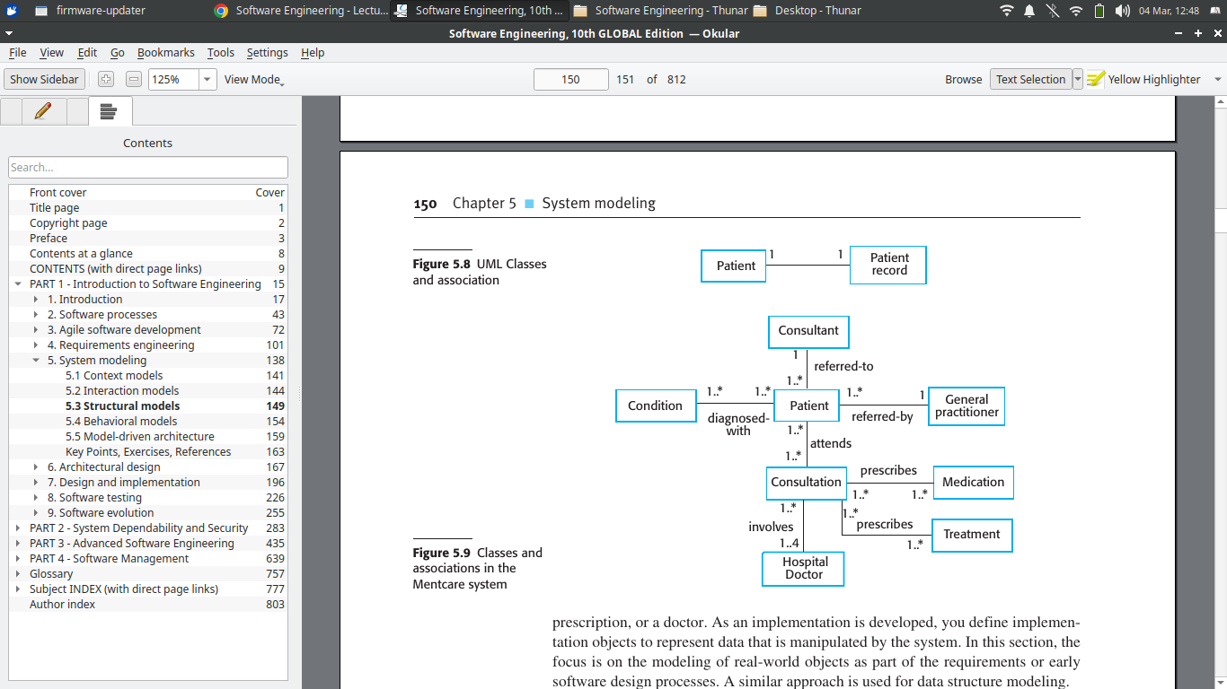
Class Diagrams
"Class diagrams are used when developing an object-oriented system model to show the classes in a system and the associations between these classes"
"An association is a link between classes indicating that some relationship exists between these classes."
Class diagrams will be covered in depth in SE lab

Slide 24
Classes and Associations in Mentcare (SOM., pg. 150)

Slide 25
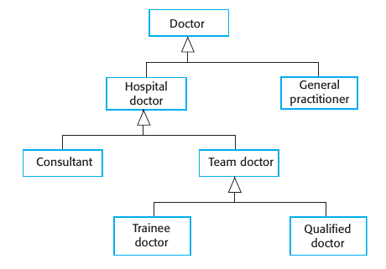
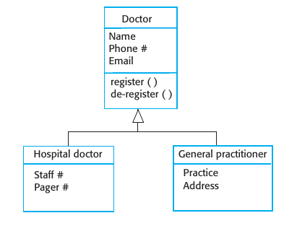
Generalization

Slide 26
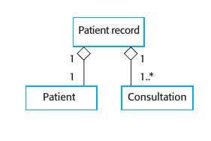
Aggregation
Does this look okay to you? Relationship wise? (oh now we are relationship experts?)

Slide 27
Pop Quiz (assuming prior knowledge of OOP)
How do you decide on what becomes a class in a class diagram?

